Slide 1


M.Tech/MCA Program
Advanced Industry Integrated Programs
Jointly offered by University and LTIMindTree
Review II
AI Based Interior Design and Renovation Cost Estimation
ANMOL CHAUBEY
24MAI0111
Knowledge partner | Implementation partner

Slide 2
AI Based Interior Design and Renovation cost estimator
Introduction
Renovation cost estimation is manual, slow, and inconsistent.
Existing calculators cover only single items (paint, flooring).
Visualization tools (IKEA/Houzz) focus on looks, not costing.
Contractor quotations are often non-standardized and biased.
Need for an AI-driven, end-to-end cost estimation system.

Slide 3
AI Based Interior Design and Renovation cost estimator
Objective
Develop an AI-driven interior cost estimation system.
Combine tabular inputs and room images.
Provide accurate and transparent renovation cost with breakdown.

Slide 4
AI Based Interior Design and Renovation cost estimator
Modules Planned
M1 – Tabular & Image Preprocessing/Modeling: Prepare clean tabular features and image representations as model-ready inputs.
M2 – Quantity Estimation: Convert room dimensions and image cues into material quantities (paint, flooring, ceiling, fixtures).
M3 – Cost Mapping: Apply city/labor/material indices to quantities to create a line-item cost breakdown.
M4 – Fusion, Calibration & Reporting: Combine all signals to predict final cost, add a reliable range, and generate the report.

Slide 5
AI Based Interior Design and Renovation cost estimator
Methodology/Modeling Plan
Use tabular data (room features, city, renovation level) for baseline predictions.
Train image model (ADE20K, COCO) to detect walls, floors, ceilings, furniture.
Fuse tabular + image features for final prediction.
Implement as a DVC pipeline for reproducibility and tracking.

Slide 6
AI Based Interior Design and Renovation cost estimator
Data preprocessing & EDA
Tabular Data: Cleaned features, encoded categoricals, scaled numerics; integrated govt. + private cost listings.
Image Data: Used COCO 2017 + ADE20K subset with unified class mappings (wall, floor, ceiling, seating, etc.).
Processing: Built semantic masks, resized images/masks to 512×512.
Validation: Sanity checks confirmed label coverage and mask quality.

Slide 7
AI Based Interior Design and Renovation cost estimator
Approach/Algorithms/Tools
Approach:
Predict costs using tabular model (room, city, renovation details).
Train image segmentation model (DeepLabV3-ResNet101) on ADE20K + COCO.
Fuse tabular + image outputs for final cost estimation.
Algorithms / Models:
Tabular: LightGBM / XGBoost.
Images: DeepLabV3-ResNet101 (semantic segmentation).
Fusion: Late fusion with meta-model (MLP/GBM).

Slide 8
AI Based Interior Design and Renovation cost estimator
Approach/Algorithms/Tools
Tools & Frameworks:
DVC for pipeline management & reproducibility.
PyTorch, torchvision for image models.
Pandas, scikit-learn for tabular processing.
Matplotlib, Seaborn for EDA & visualization.

Slide 9
AI Based Interior Design and Renovation cost estimator
Project plan/Milestone Progress
Milestones Defined
Tabular data preprocessing & model training.
Image dataset preparation (COCO + ADE20K).
Train image segmentation model (DeepLabV3-ResNet101).
Fusion of tabular + image features.
Final cost estimation, calibration & reporting.

Slide 10
AI Based Interior Design and Renovation cost estimator
Project plan/Milestone Progress
Progress Achieved
Completed tabular data preprocessing & prediction model.
Preprocessed COCO & ADE20K datasets with unified class mappings.
Trained DeepLabV3-ResNet101 with class weights.
Next Steps
Integrate image detections with tabular features.
Implement fusion model for cost prediction.
Add calibration (min–max ranges) & reporting module.

Slide 11
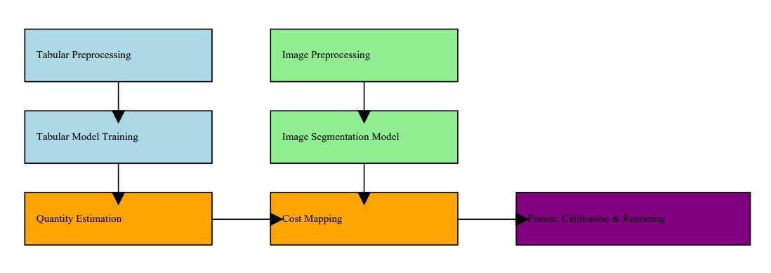
AI Based Interior Design and Renovation cost estimator
Pipeline structure

